Slide 1
CRM ANALYTICS
By:
Anuja Bharat Pawar
Govardhan kowdiki
Abhishek Kumar Prasad

Slide 2
INDEX
1st Event | 2nd Event | 3rd Event | 4th Event | 5th Event | 6th Event
Summary | KPI list | Excel | Tableau | PowerBI | SQL
Intro of project | KPI’s used | Excel Dashboard | Tableau Dashboard | PowerBI Dashboard | SQL Queries
7th Event
Key insights
Key points

Slide 3
Introduction
This CRM Analytics project focused on developing Report Analytics & Dashboard Analytics for stakeholders using Excel, SQL, Tableau, and Power BI.
Created an Excel dashboard based on provided data.
Integrated SQL by loading data into a Supply Chain schema.
Connected SQL database to Tableau and Power BI for data modelling and necessary joins.
Built interactive dashboards analyzing key metrics (opportunity trends, conversion rates, win/loss rates, and lead performance).

Slide 4
KPIs List Opportunity Dashboard KPIs
📌 Active Opportunities
Tracks the number of open and ongoing sales opportunities.
📌 Conversion Rate
Checks how well opportunities turn into deals and points out ways to improve, like better follow-ups or pricing changes.
📌 Win Rate
Monitors the percentage of opportunities that turn into successful deals.
📌 Loss Rate
Provides insights into why deals are lost (e.g., pricing issues, lack of follow-up, or strong competition).Helps refine strategies to reduce losses and improve future conversions.

Slide 5
📌 Trend Analysis
Expected vs Forecast Revenue compared projected revenue with actual performance.
Active vs Total Opportunities helped measure how many deals were actively pursued compared to the total number of opportunities.
Closed Won vs Total Opportunities showed how successful the team was at closing deals relative to the total number of leads.
Closed Won vs Total Closed measured the proportion of successful deals out of all deals that were concluded (won or lost).
📌 Expected Amount by Opportunity Type
Organizes opportunities by type and revenue so sales teams focus on big deals while managing smaller ones too.
📌 Opportunities by Industry
Tracks industry-specific trends in sales cycles, demand, and pricing.

Slide 6
Lead Dashboard KPIs
📌 Total Leads
This tracks how many potential customers the business is attracting.
📌 Expected Amount from Converted Leads
This measures how much revenue can be expected from leads that convert into customers, helping businesses focus on the most valuable prospects.
📌 Conversion Rate
A lead conversion rate measures how well leads turn into paying customers.
📌 Converted Accounts & Opportunities
This shows how many leads turn into real customers or sales chances and helps businesses see if their follow-up process is working well.
📌 Lead Analysis Metrics
Leads by Source: Finds out which platforms (like social media or email) are bringing in the best leads.
Leads by Industry: Helps identify which industries are most interested in the product or service.
Leads by Stage: Shows how leads move through the sales process, helping to find and fix any delays or problems.

Slide 7
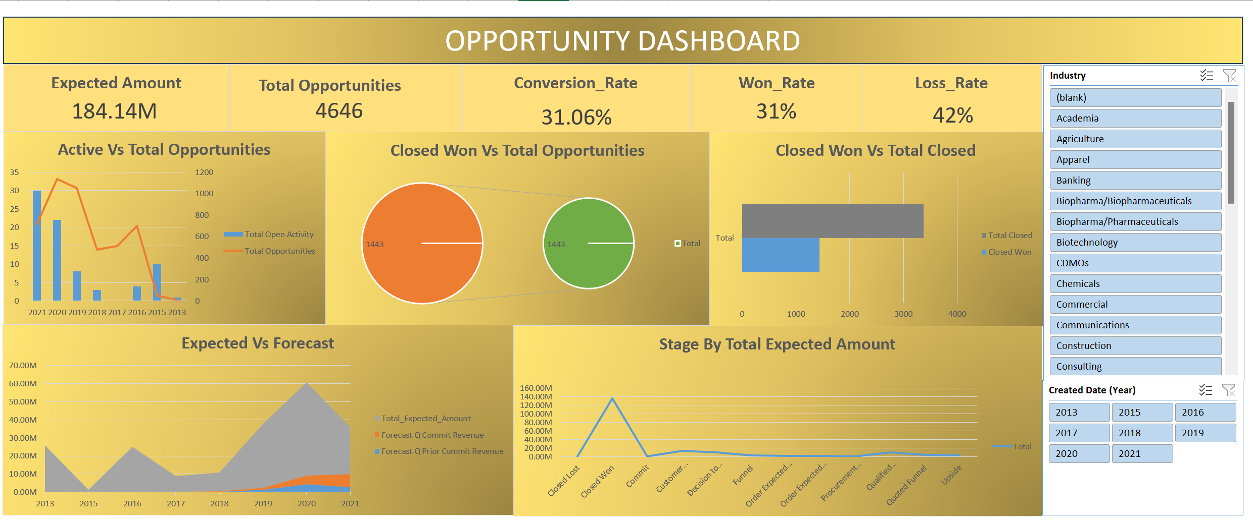
EXCEL

Slide 8
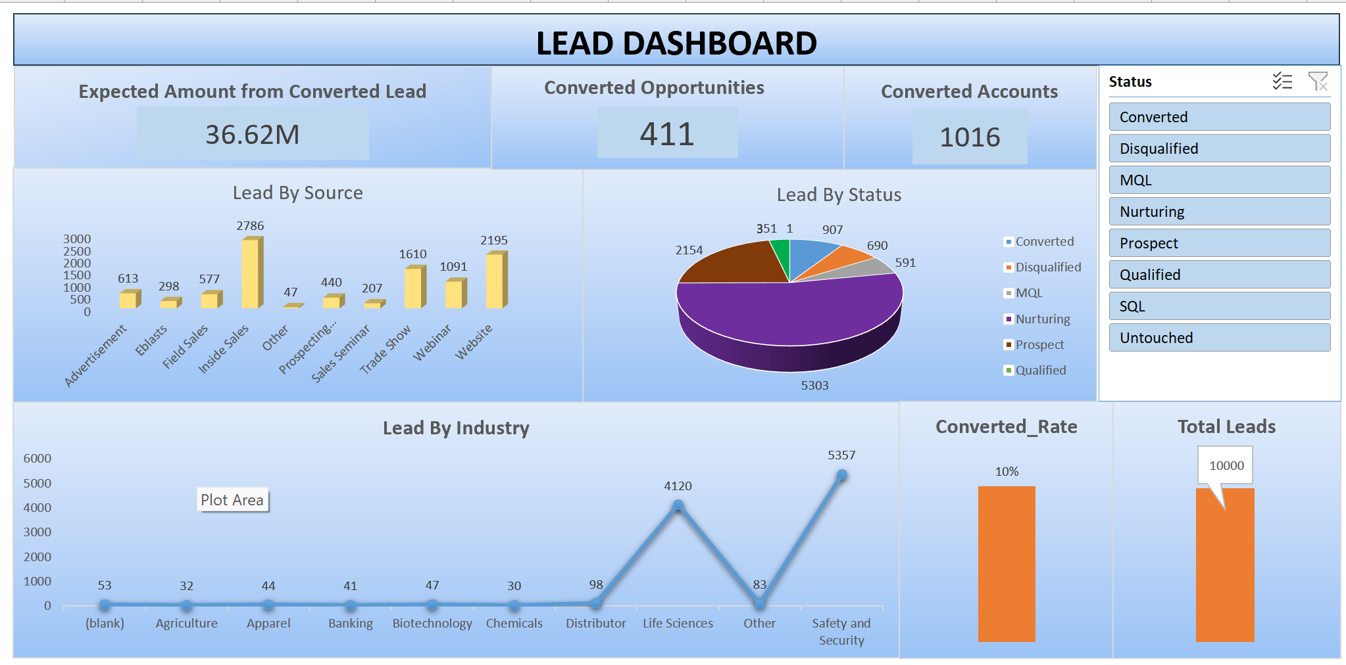
EXCEL

Slide 9
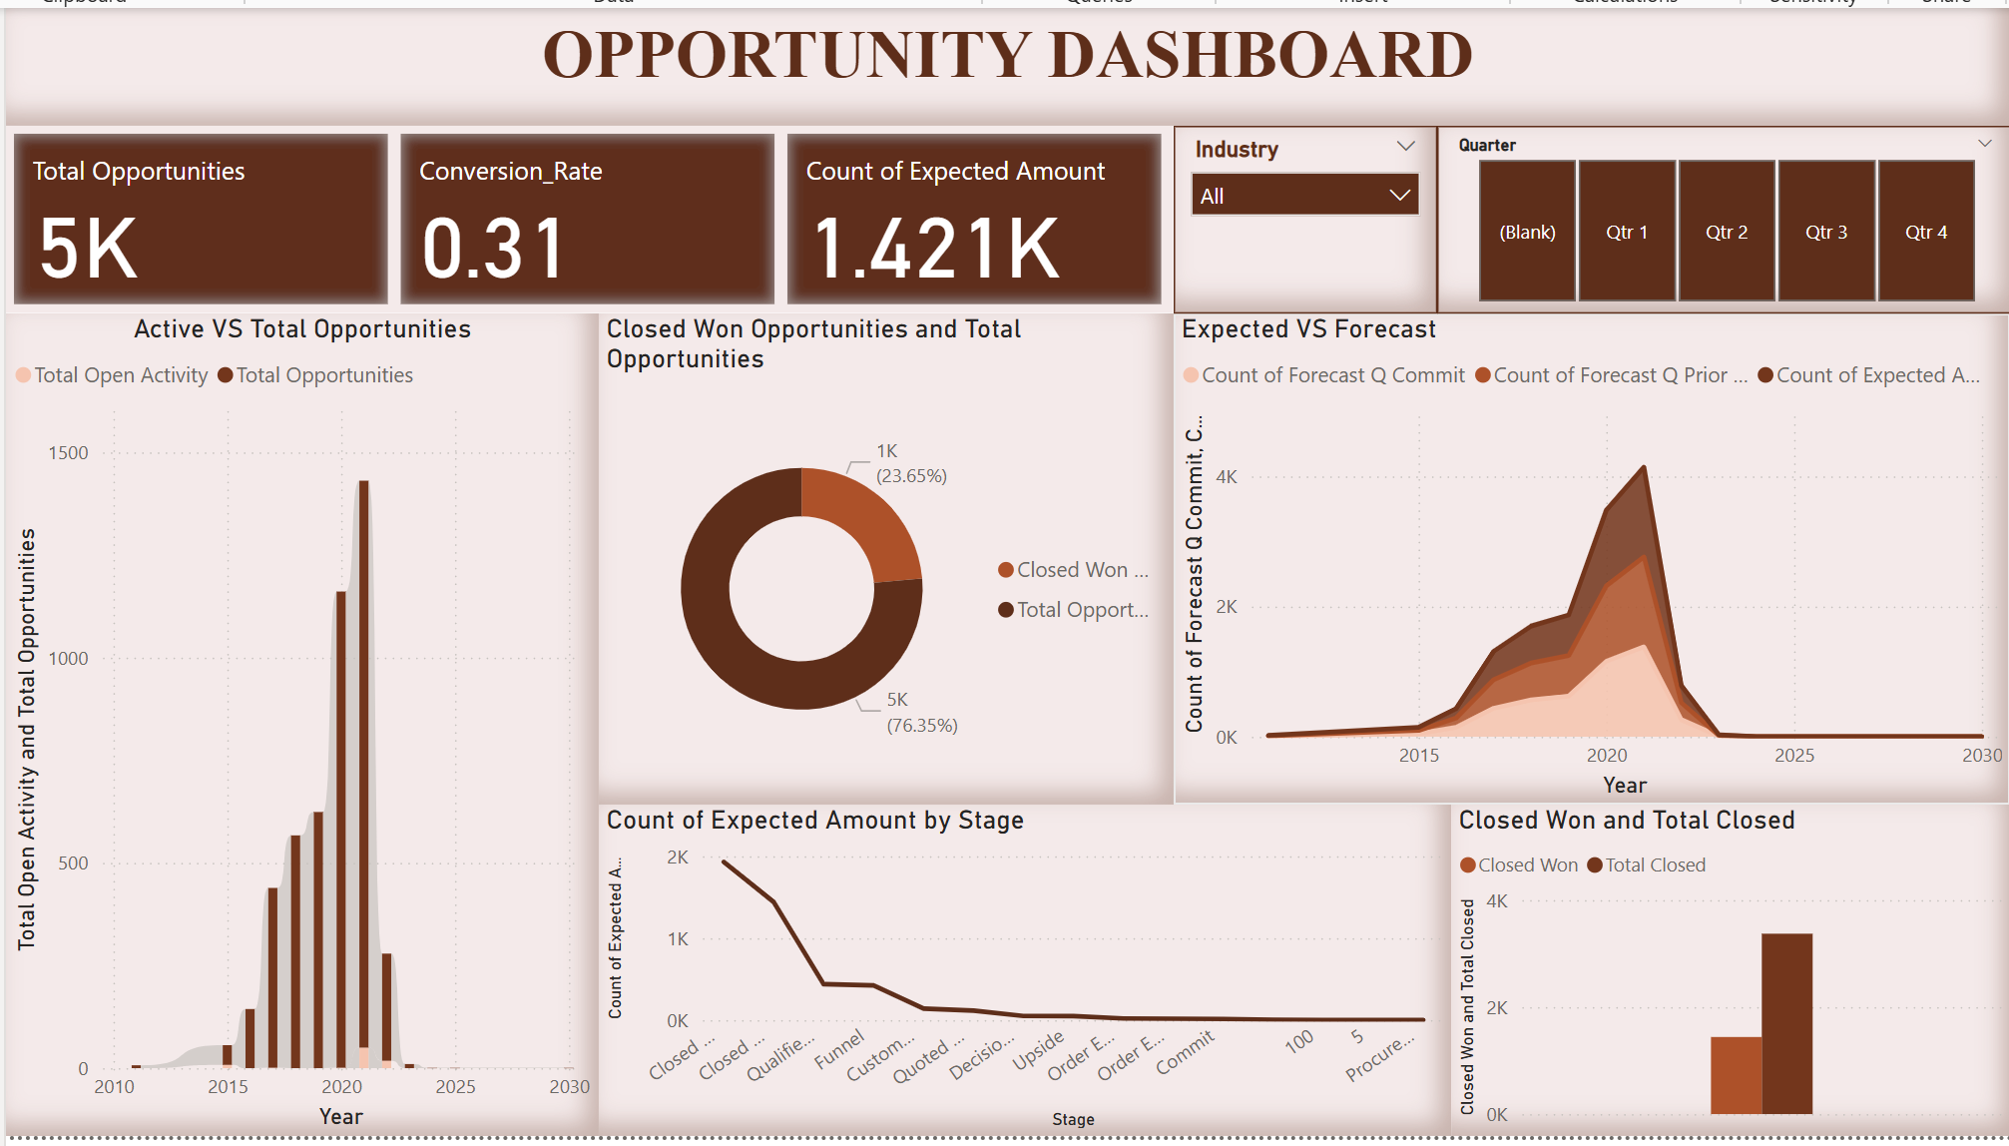
POWERBI

Slide 10
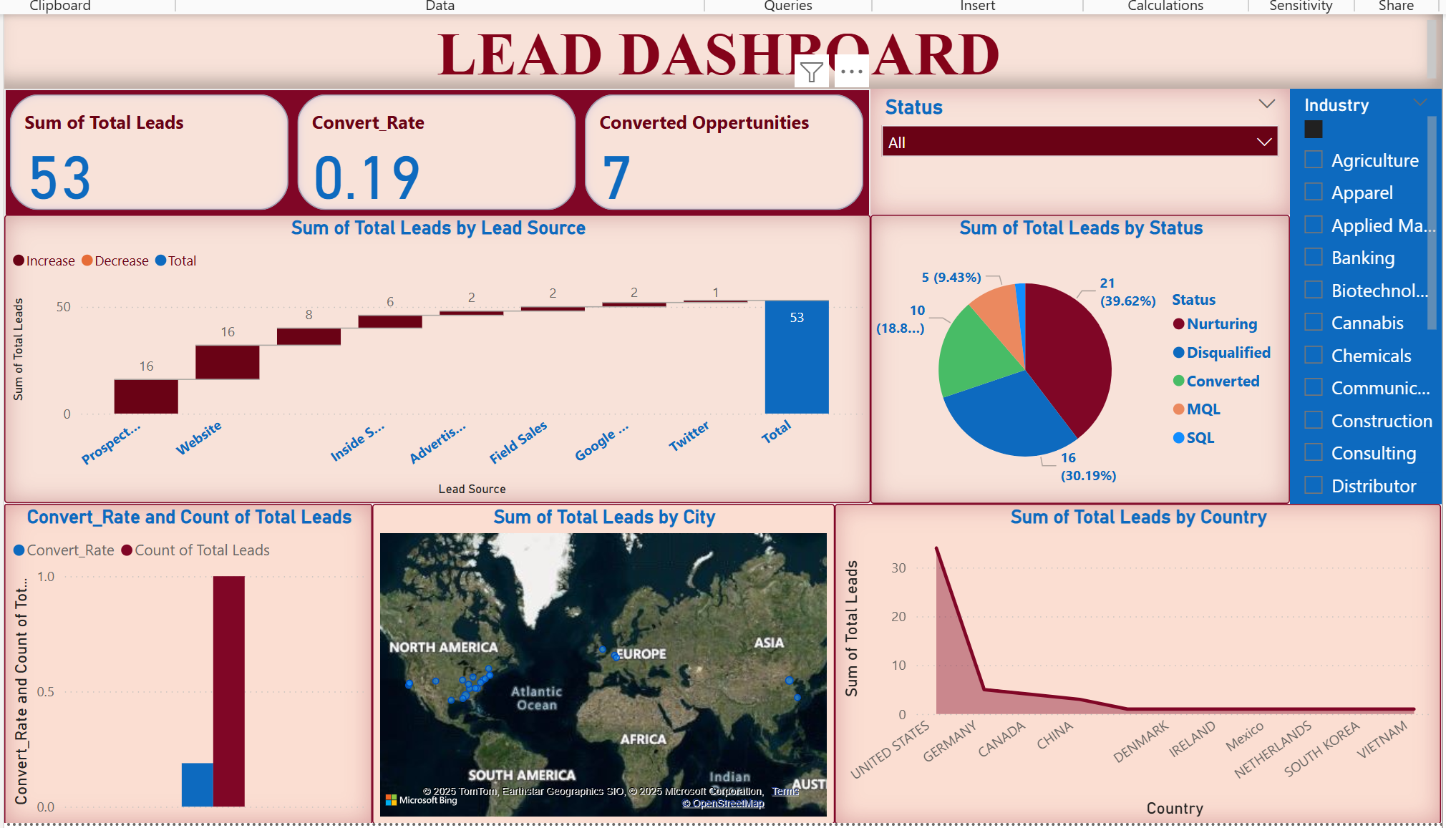
POWERBI

Slide 11
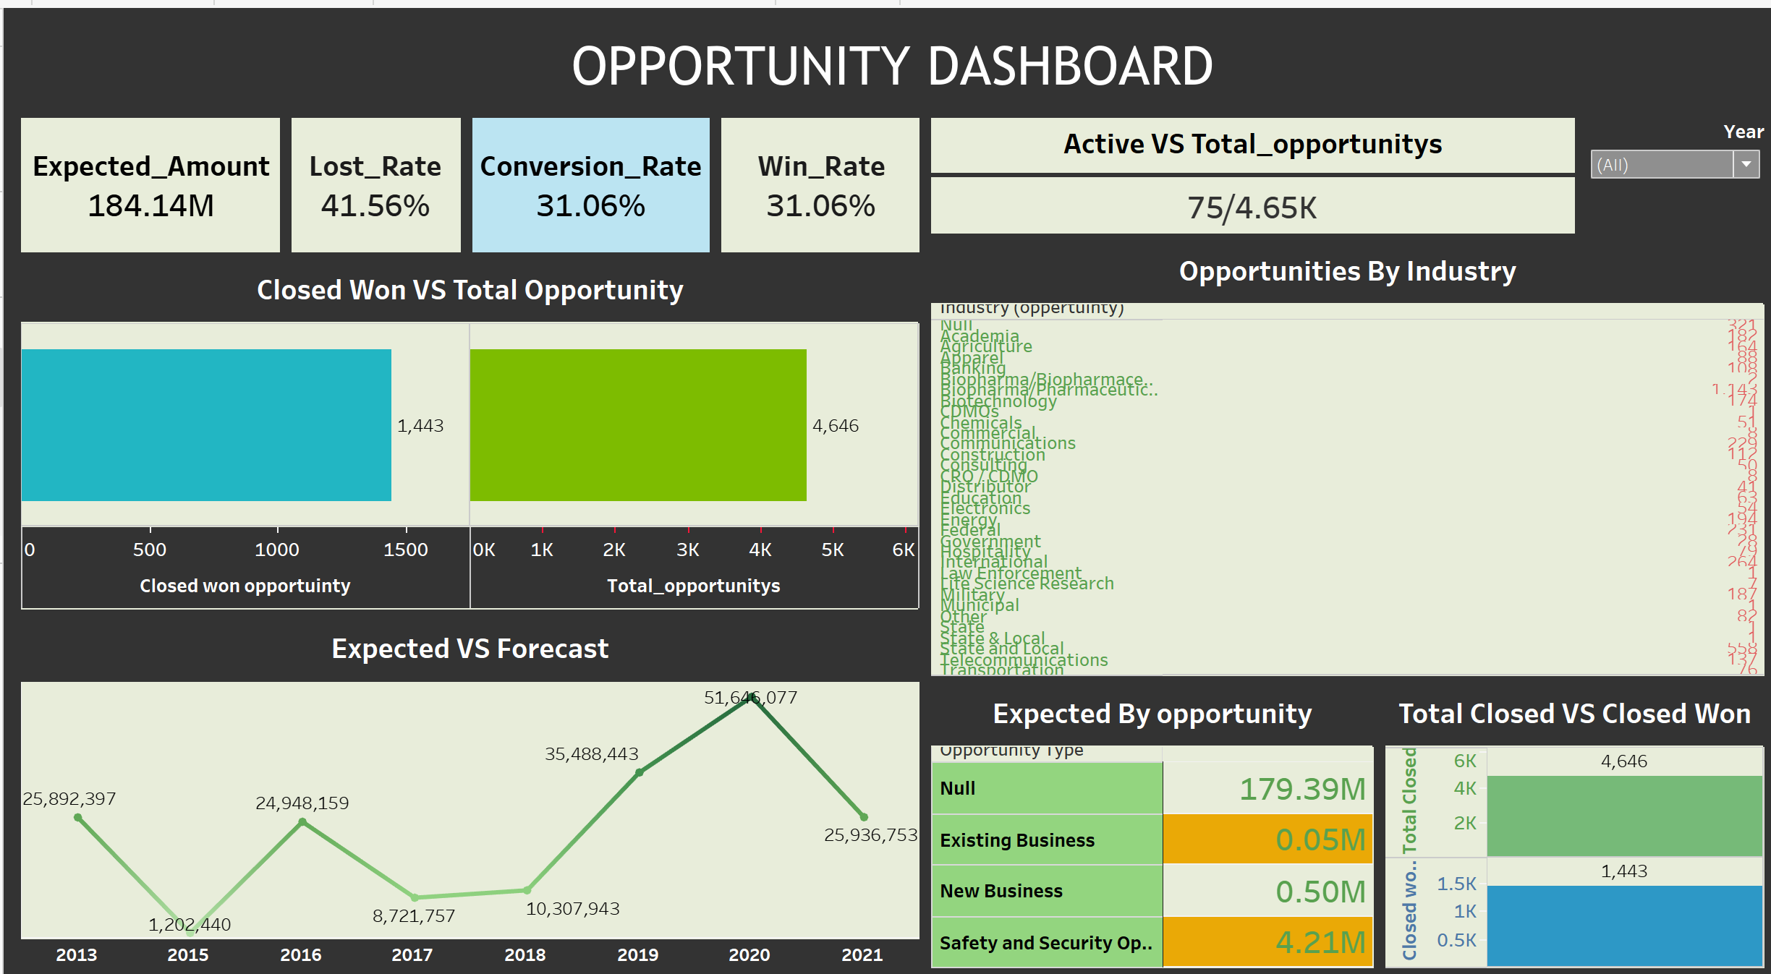
TABLEAU

Slide 12
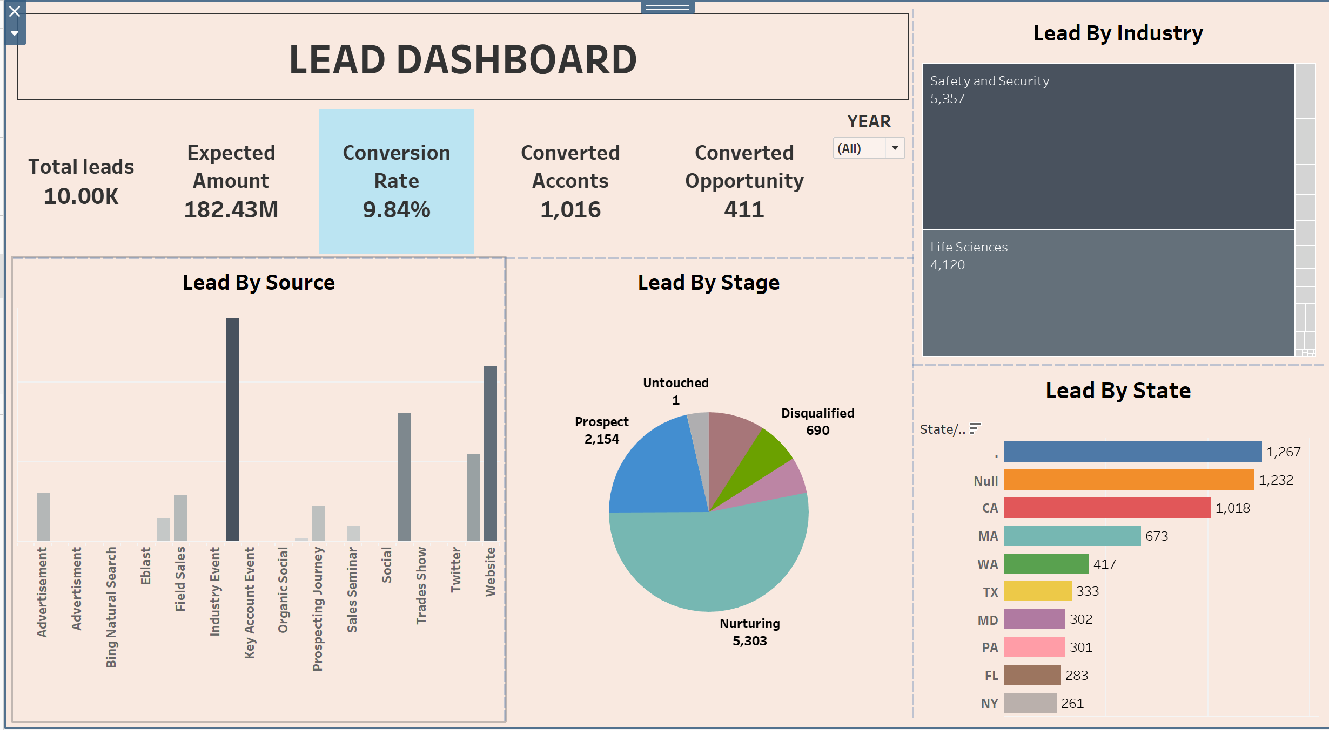
TABLEAU

Slide 13
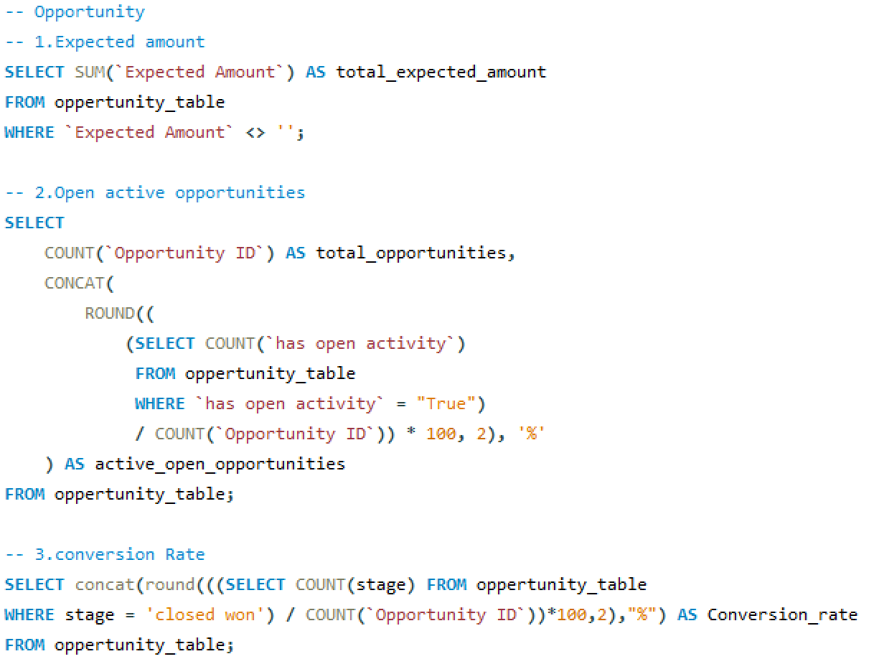
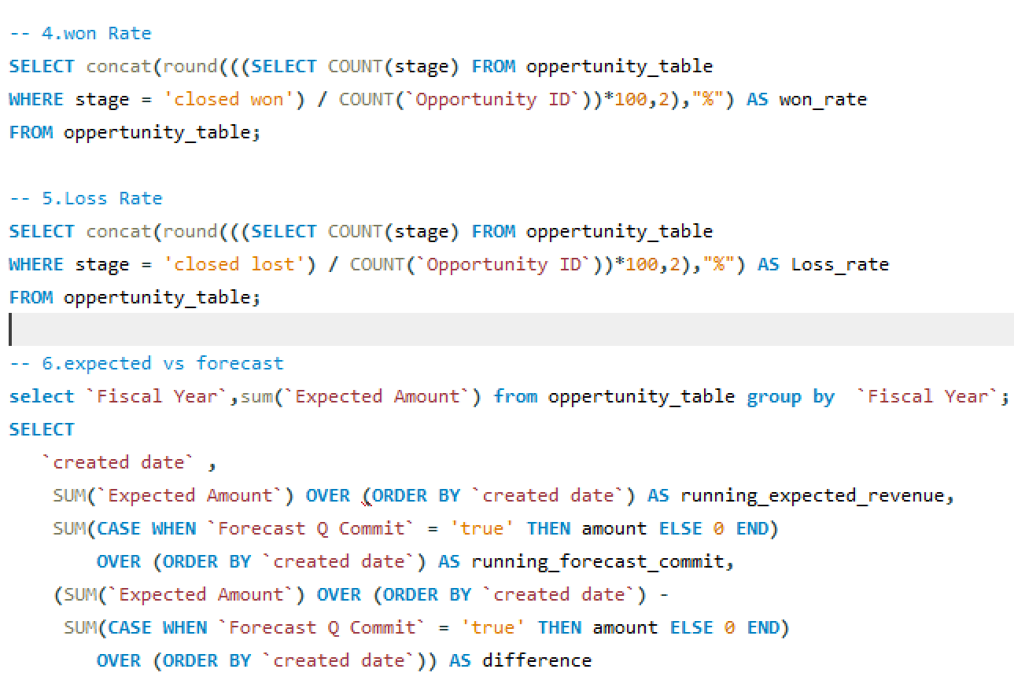
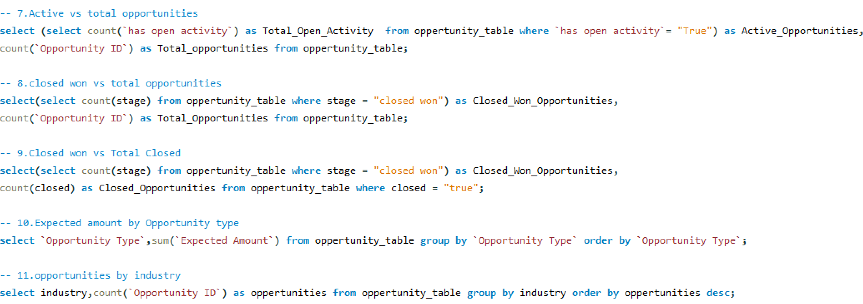
SQL

Slide 14
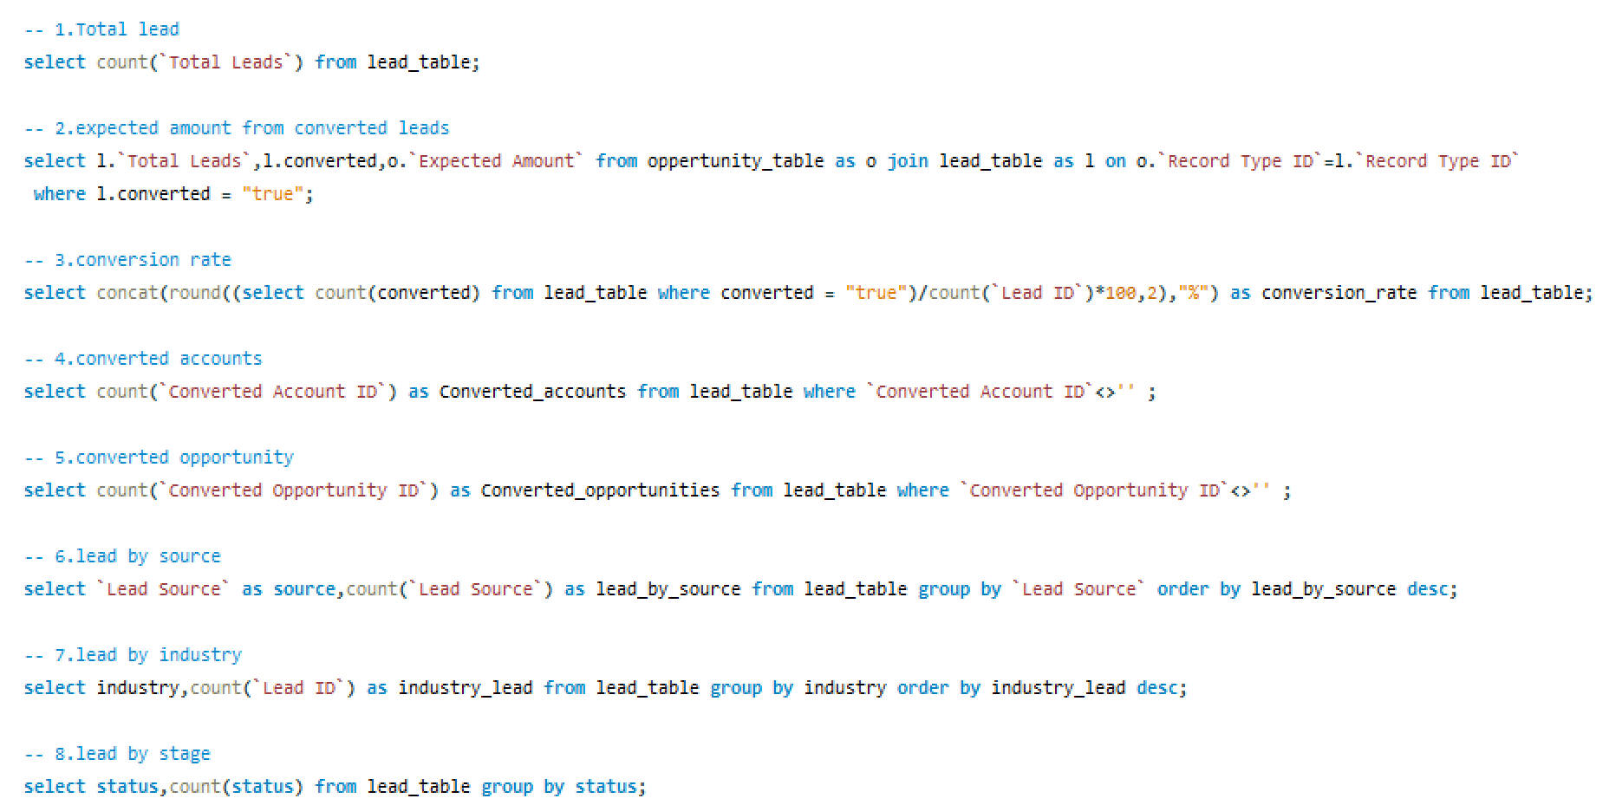
SQL

Slide 15
Key Insights
Key Takeaways from the CRM Analytics Project
🔹 1. Data-Driven Decision Making
🔹 2. Sales Performance Evaluation
🔹 3. Lead Management Optimization
🔹 4. Integration of Multiple BI Tools
🔹 5. Forecasting and Trend Analysis
🔹 6. Enhancing Stakeholder Insights

Slide 16


